Slide 1

MODULE 7: Cross-sectional studies, 1
In this Module, we learn about cross-sectional studies, the first Module in a series of Modules specific to different study designs in epidemiology
Notes:
Welcome to Module 7 and the second half of this course! This Module is the first in a series we will consider from here forwards in our class, specific to different study designs. In this Module, we will learn about cross-sectional studies, a widely utilized type of study design in epidemiology.

Slide 2
Learning Objectives
Identify key characteristics, strengths, and limitations of cross-sectional studies
Calculate and interpret appropriate measures of occurrence, association
Identify and describe relevant sources of bias (e.g., incidence-prevalence bias)
Notes:
By the end of this Module, you should be able to identify key characteristics, strengths, and limitations of cross-sectional studies. You should also be able to identify, calculate, and interpret measures of occurrence and association appropriate for cross-sectional studies. Finally, you should be able to identify and describe relevant sources of bias. Incidence-prevalence bias is one example we will consider.

Slide 3
Part A: Study Design and Basics
Fundamentals regarding this study design
Notes:
Let’s get started with fundamentals specific to this study design – that is, the basics!

Slide 4
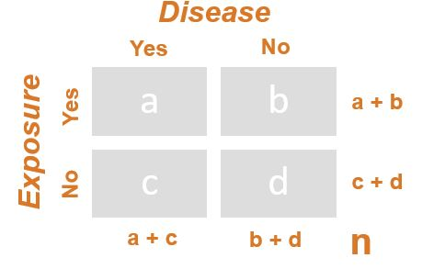
Data Collection
Notes:
Cross-sectional studies are one of the most frequently utilized observational epidemiologic studies.
Remember, in a cross-sectional study, we begin by selecting a single sample (n) from a population (often referred to as N). If our source population is small, we can study them all; but, usually it is large, so we must choose a sample or subset of them. As we gather data for our single sample on each individual’s exposure and outcome status, we can place these participants into our 2X2 table to fill cells a, b, c, and d. From there, we can calculate epidemiologic measures of occurrence (e.g., prevalence) and measures of association (e.g., prevalence ratio).

Slide 5
Characteristics
The primary “unit” is the individual
Exposure(s), outcome(s) are measured at same time, in same (i.e., one) sample
Thus, estimates consider only prevalence
Notes:
In cross-sectional studies, the primary unit of data collection and analysis is the individual, not a group (such as we would find in ecologic studies). Many surveillance systems or surveys use cross-sectional studies as their foundation or backbone. In cross-sectional studies like these, multiple exposures and outcomes relevant to a specific health issue can be measured at the same time in the same sample. In doing so, the study examines the prevalence of the exposures and/or outcomes in the sample, as all data are collected at a specific point in time.
In Epi 1, you learned several key characteristics of cross-sectional studies that are worth reviewing here. As we just noted, all data collection occurs at only one point in time in this study design. Although a cross-sectional survey might ask study participants to recall a past exposure, like case-control studies do, the data on the exposure and the outcome are always collected at the same point in time, such as at a single survey administration. Moreover, this is done for a single sample, not two, like in case-control studies where diseased and non-diseased samples are identified at the onset of the investigation as cases and controls or cohort studies where two or more samples are first identified according to their exposure status as exposed and unexposed. Like case-control and cohort studies, but unlike ecologic studies, the primary unit of both data collection and analysis in cross-sectional studies is the individual, not the group. Finally, because data are only collected at one point in time, cross-sectional studies can only estimate prevalence ‘rates’, not incidence. This can lead to an important source of bias we will discuss towards the end of this presentation.

Slide 6
Research Questions
Descriptive epidemiology
Prevalence, outcome
Prevalence, exposure(s)
Surveillance data on same
Notes:
Descriptive cross-sectional studies simply characterize the prevalence of a health outcome and/or related exposures in a specified population. These data can be derived from and/or inform a wide variety of public health surveillance systems. Prevalence measures are commonly used to inform public health policy and planning, as well as administration of preventive or health care services. Prevalence data are the “bread and butter” of epidemiology, really. Determining what proportion of the population is ill or well is key to public health.

Slide 7
Research Questions
Analytic epidemiology
Descriptive(s) = analytics
Initial hypothesis testing
Specific to prevalence estimates
Notes:
In analytical cross-sectional studies, descriptive data on the prevalence of an exposure and outcome of interest are linked together (e.g., in a 2X2 Table). This is done to conduct initial hypothesis testing to investigate whether the exposure and outcome are related to each other.
Cross-sectional studies are useful for establishing preliminary evidence that can be tested again in subsequent studies using stronger study designs (e.g., cohort studies). As we will see later, all statistical testing is limited to prevalence ratios, so provide an indirect estimate of risk.

Slide 8

Example
Notes:
Cross-sectional studies are widely utilized in epidemiology, as they can be a “quick” and comprehensive solution to epidemiologic research. Many surveillance systems, like NHANES or the National Health and Nutrition Examination Survey, for example, are grounded in cross-sectional surveys and studies. These surveys are able to collect a wide variety of information on multiple exposures and multiple outcomes that can be analyzed in separate cross-sectional investigations. This provides information that not only describes the prevalence of varied public health problems in a specific population at one point in time, but also analyzes and assesses potential causes and cures of the same. Therefore, cross-sectional studies can be used for both descriptive epidemiology (e.g., to generate hypotheses and/or plan public health program) and analytic epidemiology (e.g., to test hypotheses and/or assess risk factors for disease). In this or any other cross-sectional study, disease (or outcome) status can determined by self-report on a survey, physical examination, or other procedures (e.g., lab tests, x-rays). Exposure status is usually obtained from surveys or interviews, but could also include medical records, lab tests, physical exam, or other means.

Slide 9

Example
Notes:
The Behavioral Risk Factor Surveillance System (BRFSS) is the nation’s premier system of health-related telephone surveys that collect state data about U.S. residents regarding their health-related risk behaviors, chronic health conditions, and use of preventive services. Established in 1984 with 15 states, BRFSS now collects data in all 50 states as well as the District of Columbia and three U.S. territories. BRFSS completes more than 400,000 adult interviews each year, making it the largest continuously conducted health survey system in the world. By collecting behavioral health risk data at the state and local level, BRFSS has become a powerful tool for targeting and building health promotion activities. BRFSS is another example of a surveillance system built off of cross-sectional studies.

Slide 10
Strengths
Helpful for planning health programs
Efficient, as they are inexpensive, quick
Useful for more common outcomes
Useful for more common exposures
Useful for diseases with long duration
Notes:
Cross-sectional studies are useful for outcomes that are common and have a long duration, as there would be enough sample size to study. The same is true for common exposures, too. Cross-sectional studies can also be useful for planning health promotion or disease prevention programs, as they can provide a reasonable estimate of the prevalence of a particular disease(s) and/or relevant exposure(s), so funds and activities can then be allocated accordingly. Cross-sectional studies are also efficient, as they are relatively inexpensive and can be quick to conduct. Data can be collected for a wide variety of outcomes and exposures in a cross-sectional study (e.g., surveillance research) at the same time, allowing investigators to study or test several different research hypotheses under a single study umbrella, too. A cross-sectional design can ultimately be a good choice in epidemiology for both descriptive and analytic studies.

Slide 11
Strengths
For diseases that are (of),
Slow onset
Long duration
Relatively advanced
Cannot be identified at onset
Notes:
Cross-sectional studies may be a better design for diseases of slow onset, long duration, and those for which medical care is not sought until the disease is relatively advanced (e.g. chronic bronchitis, osteoarthritis, mental disorders). Or the cross-sectional study design may be a good design for diseases that cannot be identified at onset such that only prevalent cases can be identified: congenital malformations, chronic conditions with poorly-defined onset times and limited effects on mortality, or asymptomatic chronic infections or conditions that are identifiable only by screening for antibodies or other biomarkers. These studies are also useful for examining the association between exposure and disease onset for chronic diseases where we do not have information on time of onset.

Slide 12
Limitations
There is often temporal ambiguity
They can only estimate risk indirectly
Inefficient for particularly rare outcomes
Inefficient for especially rare exposures
Inefficient for diseases of short duration
Notes:
The primary limitation of cross-sectional studies is that there may be temporal ambiguity. Oftentimes, we simply do not know whether the exposure preceded the outcome, or vice versa. Moreover, these studies only provide an “indirect” estimate of risk (which can be biased in the ways we have just discussed), as the focus is on prevalent exposures and outcomes, not on incident ones. Finally, they are inefficient for studying really rare outcomes or exposures (e.g., much less than 5%) or diseases of short duration, as an especially large sample would have to be identified in order to power the study sufficiently, making it cost prohibitive.

Slide 13
Part B: Data Collection
In this section, we consider sampling and measures
Notes:
Despite these limitations, cross-sectional studies remain widely utilized in epidemiology today. Let’s consider issues related to sampling and measurement, within them.

Slide 14
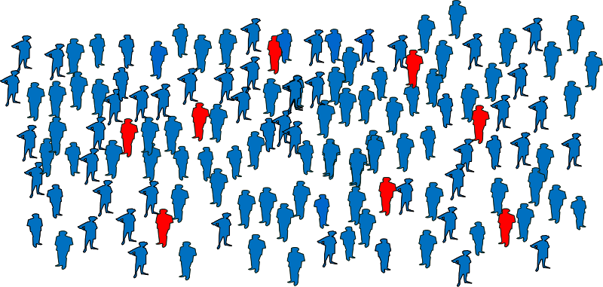
Participants
Notes:
In this Module, to talk about how a sample of participants are selected from a population, we direct you to an outside video by Dr. Raul Caetano, who used to teach this course from the Dallas Campus. He’s an expert in sampling methodology and its application inside cross-sectional studies – so who better to listen from than him? The link to this video is provided on your Instruction Sheet for this Module.

Slide 15
Measurement
Census data
Vital statistics (e.g., birth, death)
Clinical records
Survey data (e.g., cohort studies)
Notes:
Data can be collected in a wide variety of ways in cross-sectional studies. Census data are commonly used in these studies, as are vital statistics data, like birth certificate and death certificate data. Clinical records and electronic medical files can be the source of data for these studies, as can survey data. Sometimes, repeated surveys give birth to cohort studies, or cross-sectional studies can be nested in a cohort study. In a moment, we will consider baseline data from the Framingham Heart Study, a cohort study that began back in 1947.

Slide 16
Bias (i.e., systematic error)
Selection Bias
Duration Ratio Bias
Prevalence Complement Ratio Bias
Information Bias
Temporal Bias
Notes:
As we know, error is not uncommon in epidemiology. Each study design has its own unique source of systematic error, or bias. At the end of this presentation, we will consider different sources of selection bias and information bias that are unique to cross-sectional studies.

Slide 17
Part C: Data Analysis
Measures of occurrence and association
Notes:
In the next Module, we will introduce hypothesis testing and simple regression models as a way to conduct data analysis in cross-sectional studies. In this Module, however, we will review simple measures of occurrence and association that are relevant to cross-sectional studies.

Slide 18

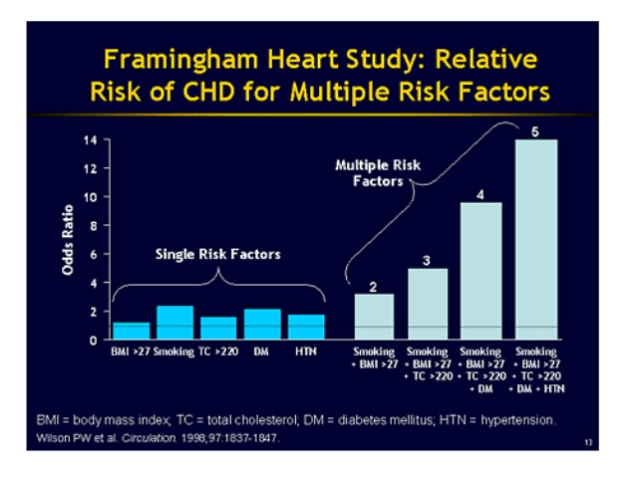
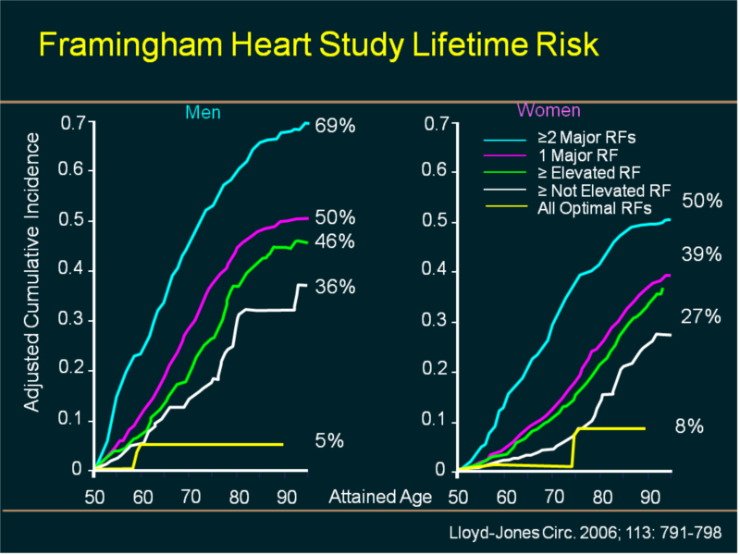
Framingham Heart Study
Example
Notes:
To move through this section, we will use the Framingham Heart Study as an example. The Framingham Heart Study is a long-term, cohort study of residents of the city of Framingham, in Massachusetts. The study began in 1948 with 5,209 adult subjects from Framingham, and is now on its fourth generation of participants! Prior to the study almost nothing was known about the epidemiology of hypertension or cardiovascular disease. Much of the now-common knowledge concerning heart disease, such as the effects of diet, exercise, and common medications like aspirin is based on this study. The Framingham Heart Study gave birth to the “Framingham risk score,” which is essentially an algorithm to predict the probability of heart disease, given the presence or absence of multiple risk factors for the same in individuals. The Framingham Heart Study was one of the first to peg smoking as an important risk factor for hypertension and cardiovascular disease. This however, as we will see in our example this presentation, was not the outcome of its initial investigation – which showed the opposite.

Slide 19

Framingham Heart Study
Parent cohort
Cross-sectional study
Notes:
Some cross-sectional studies, like some case-control studies, can be nested within a parent cohort or original cohort study. This is the case with the example that we will provide today, from the Framingham Heart Study. With it, we examine the relationship between cigarette smoking and hypertension at baseline, back in 1948 when the study collected its first wave of data. Later findings reported from the study would have made use of incident data over time, as repeated measures were collected on the same individuals in subsequent waves. But, in this Module, we only consider prevalent data. This can be problematic if we wish to estimate the risk associated with cigarette smoking.

Slide 20
Data Analysis
Measures of occurrence
Prevalence - outcome(s)
Prevalence - exposure(s)
Notes:
The simplest measures we can compute and use in a cross-sectional study are the prevalence of the outcome(s) and the prevalence of the exposure(s). The nice piece about cross-sectional studies, of course, is that we can study multiple outcomes and multiple exposures, if/as needed. These measures of occurrence, albeit simple, can often be the most powerful to report, as epidemiologists seek to describe what is happening at a population-level. In cross-sectional studies, these figures often fill in a ‘Table 1’ for publications and are increasingly used in infographics for lay audiences, too. These measures of occurrence are especially relevant as we seek to communicate with stakeholders about the absolute burden a specific outcome(s) or exposure(s) has on a population. These figures anchor us into the analytic work we do.

Slide 21
Data Analysis
Disease
Yes
No
a
b
c
d
a + b
Yes
Exposure
No
c + d
a + c
b + d
n
Notes:
In the next Module, we will go beyond our usual 2X2 Table to talk through more advanced analytic techniques, like regression. For now, though, please be patient, as we continue to employ this useful device, here. Using it, we will review simple formula you should know now.

Slide 22
Framingham Heart Study
Hypertension
Yes
No
592
1589
838
1415
2,181
Yes
Smoking
No
2,253
1,430
3,004
4,434
Notes:
To do so, we will use data from the Framingham Heart Study, at baseline (i.e., Wave 1). Four thousand four hundred and thirty four people participated in this Wave and were eligible for this analysis. The outcome we consider is hypertension and the exposure cigarette smoking. The distribution of this sample by these factors is shown in this slide. These data will drive all of the calculations that shall follow from here.

Slide 23
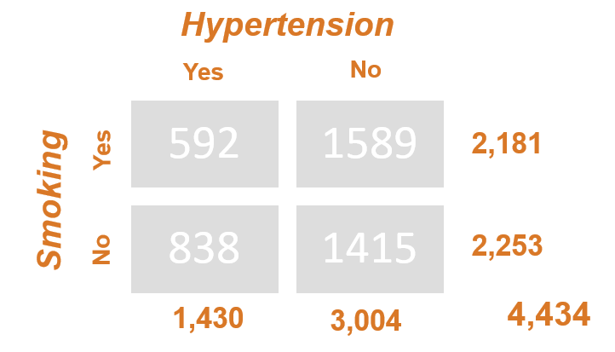
Data Analysis
Prevalence – outcome – point estimate
a + c
prev_{o}
=
n
1430
prev_{o}
=
4434
prev_{o}
=
32.3%
Notes:
Let’s start with calculating the prevalence of the outcome in the sample, denoted here by “prev” with the subscript “o”. The formula for this calculation is a plus c, all divided by n. Pulling from marginals, we divide 1430 by 4434. In this sample, 32.3% of adults had hypertension.

Slide 24
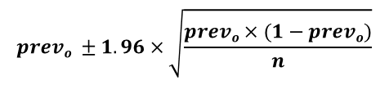



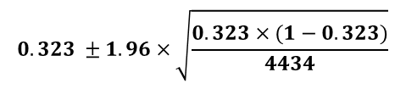
Data Analysis
Prevalence – outcome – 95% CI
32.3% (30.9 – 33.7)
$$prevo ±1.96×\sqrt{\frac{prevo×(1−prevo)}{n}}$$
$$0.323 ±1.96×\sqrt{\frac{0.323×(1−0.323)}{4434}}$$
$$0.323 ±1.96×0.007$$
$$0.323 ±0.014$$
or
$$(0.309, 0.337)$$
Notes:
The percentage we calculated in the previous slide is called a point estimate. This, as we know, describes the magnitude of the problem. Here, we calculate the 95% CI around this estimate, which describes the precision with which we are able to estimate it. The formula for this calculation is not shown in your textbook (as far as we know), but is provided here, on the top right. This is called the “approximate” confidence interval or a Wald confidence interval, and it is based on a standard normal distribution in the population. Software packages, like Stata, can also be used to calculate an “exact” confidence interval based on a binomial distribution, instead (but this calculation is too complicated to do easily by hand here). As we have chosen a 95% CI, the Z-value we use in this calculation is 1.96. This is multiplied by the square root of a mathematical computation that includes the prevalence and sample size. Here, we plug in 0.323 for prevalence (given the 32.3% we calculated on the previous slide) and 4434 as the total sample size in the study. We encourage you to do the math that follows. Moving forward with the computation, we find that we must multiply the Z-value by 0.007. In doing so, we find our prevalence estimate, at 32.3%, likely varies by 1.4% percentage points, either up or down. Thus, we report 32.3% and a confidence interval of 30.9% to 33.7%. In lay terms, we can say “we are 95% confident that the true prevalence of hypertension in the population (from which this sample is drawn) ranges between 30.9% and 33.7%.” In statistical or mathematical terms, the 1.4 percentage points are considered to be a “margin of error.”

Slide 25
Data Analysis
Prevalence – exposure – point estimate
a + b
prev_{e}
=
n
2181
prev_{e}
=
4434
prev_{e}
=
49.2%
Notes:
We can apply these same formula and principles to calculate a point estimate and 95% confidence interval for the prevalence of exposure, too. The prevalence of exposure is denoted here by “prev” with the subscript “o.” The formula for this calculation is a plus b, all divided by n. Pulling from marginals, we divide 2181 by 4434. In this sample, 49.2% of adults smoked cigarettes. Remember, this “baseline data” is from just before 1950. (Although these historical studies may seem old, they are classic examples that are good for teaching and learning!)

Slide 26



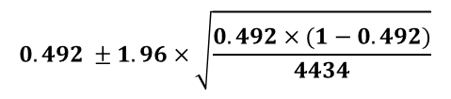
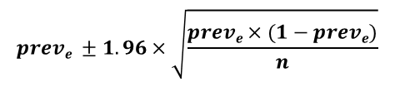
Data Analysis
Prevalence – exposure – 95% CI
49.2% (47.6 – 50.8)
$$preve ±1.96×\sqrt{\frac{preve×(1−preve)}{n}}$$
$$0.492 ±1.96×\sqrt{\frac{0.492×(1−0.492)}{4434}}$$
$$0.492 ±1.96×0.008$$
$$0.492 ±0.016$$
or
$$(0.476, 0.508)$$
Notes:
We use the same formula, again, to calculate a 95% confidence interval around this point estimate of the prevalence of exposure. Here, we plug 0.492 into the formula, given the prevalence we calculated at 49.2%. We continue to work with the same sample size, of course, at 4434. Doing so, we find we must multiply our Z-value by 0.008, such that our “margin of error” for this calculation of prevalence becomes 1.6%. In lay terms, “we are 95% confident that the true prevalence of smoking in the population (from which this sample is drawn) ranges between 47.6% and 50.8%.” The precision with which we have measured the prevalence of the exposure and the outcome is “strong.” This is due “largely” to a large sample size (n=4,434) we were fortunate to have. The larger the sample size, the tighter the confidence interval.

Slide 27
Data Analysis
Measures of association
Prevalence ‘rate’ ratio (PR)
Prevalence odds ratio (POR)
Notes:
What about the relationship between cigarette smoking and hypertension? In cross-sectional studies, we have the choice of two measures of association, the prevalence ‘rate’ ratio (PR) and the prevalence odds ratio (POR). Note that the use of ‘rate’ here is in parentheses, as measures of prevalence do not explicitly consider time in ways that measures of incidence do. Yet, at times, prevalence can be referred to as a ‘rate,’ like here. Next week, we will introduce regression as a way to calculate these measures of association. Here, we do this by hand.

Slide 28
Data Analysis
Prevalence ‘rate’ ratio (PR) – point estimate
prev_{o-exp}
PR
=
prev_{o-unexp}
a / (a + b)
PR
=
c / (c + d)
592 / 2181
PR
=
=
0.728
838 / 2253
Notes:
The formula for the prevalence ‘rate’ ratio (PR) is the same as the formula we have used before. Here, we integrate the formula with other notation employed in this Module. The prevalence ratio is just that – a ratio of the prevalence of the outcome in the exposed group (prev_{o-exp}), compared to the prevalence of the outcome in the unexposed group (prev_{o-unexp}). Computing the needful, we calculate a PR as 0.728.
The prevalence of hypertension was 27.2% lower among the smokers compared to the non-smokers.

Slide 29

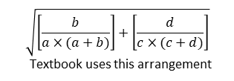

Data Analysis
Prevalence ‘rate’ ratio (PR) – 95% CI
0.728 (0.669 – 0.796)
$$\sqrt{\left[\frac{b}{a×(a+b)}\right]+\left[\frac{d}{c×(c+d)}\right]}$$
Textbook uses this arrangement
$$e\left\{lnPR ±1.96×\sqrt{\left[\frac{b/a}{(a+b)}\right]+\left[\frac{d/c}{(c+d)}\right]}\right\}$$
e $\left\{\ln\left(0.728\right)±1.96 ×\sqrt{\frac{1589/592}{2181}+\frac{1415/838}{2253}}\right\}$
e {-0.402, -0.228}
or
(0.669, 0.796)
Notes:
The formula for the 95% confidence interval for this prevalence ratio can also be found in your book, in Appendix A. Note here that we have made a few modifications to it, just to simplify the math involved. First, we have rearranged that which is represented under the square root sign. Mathematically, the two arrangements shown here are the same. Next, note we have traded in the “log” for “ln” and, accordingly, the “exp” for “e.” This is because to calculate confidence intervals, we must work with a “natural logarithmic” function, which is represented as “ln.” The natural logarithm (i.e., “ln”) of a number is the logarithmic function (i.e., “log”) to the base of the mathematical constant “e” (where “e” is an irrational and transcendental number approximately equal to 2.718281828459). This is not made especially explicit in your textbook, so we attempt to do a better job of that, here. We invite you to complete the math shown here to calculate the needful, on your own. When we did so, we calculated a confidence interval for this prevalence ratio (PR) which ranged from 0.669 to 0.796.

Slide 30
Data Analysis
Prevalence Ratio
Results | Interpretation
Prevalence Ratio > 1.0 | POSITIVE ASSOCIATION – the prevalence ‘rate’ in the exposed group is greater than the prevalence ‘rate’ in the unexposed group
Prevalence Ratio < 1.0 | NEGATIVE ASSOCIATION – the prevalence ‘rate’ in the exposed group is lower than the prevalence ‘rate’ in the unexposed group
Prevalence Ratio At or Near 1.0 | NO ASSOCIATION – the prevalence ‘rate’ in the exposed group is similar or the same as the prevalence ‘rate’ in the unexposed group
Notes:
The confidence interval for this prevalence ratio does not contain 1. Without any formal statistical testing, we could say, then, that this prevalence ratio is “significantly less than 1.” In this cross-sectional study from the Framingham Heart Study at baseline, investigators thus detected a negative association between smoking and hypertension. That is, the prevalence of hypertension among smokers was lower than the prevalence of hypertension among nonsmokers. This is counterintuitive to what we know now! But, remember, this study started before 1950. The first Surgeon General’s Report on the effects of smoking wasn’t published until 1964. Findings can surprise, at times.
Because the prevalence ratio (PR) is based on point prevalence, its interpretation is best restricted to statements about the frequency or prevalence of the outcome in the index (exposed) group relative to the comparison (unexposed) group. These interpretations thus follow,
A prevalence ratio above 1.0 means that the outcome of interest occurred more among the exposed than among the unexposed.
A prevalence ratio below 1.0 means that the outcome of interest occurred less among the exposed than among the unexposed.
A prevalence ratio at or near 1.0 means the outcome of interest occurred with the same frequency in the exposed and unexposed.
For example, a prevalence ratio (PR) of 2.0 indicates that the outcome is twice as great or as common in the exposed group as compared to the unexposed group. A prevalence ratio (PR) of 0.5 indicates that the outcome is ½ as common in the exposed group as compared to the unexposed group. In our example from the Framingham Heart Study, we calculated a prevalence ratio (PR) of 0.728. This means that the prevalence of hypertension was 27.2% less common in smokers compared to nonsmokers, given these baseline data. Results from later studies, which utilized longitudinal data and focused on incidence, showed opposite findings. We will explore prevalence-incidence bias towards the end of this Module. This example here could also be provided as an (extreme) example of prevalence-incidence, bias, as well.

Slide 31
Data Analysis
Prevalence odds ratio (POR) – point estimate
odds_{o-exp}
POR
=
odds_{o-unexp}
a / b
POR
=
c / d
592 / 1589
POR
=
=
0.630
838 / 1415
Notes:
Remember, in cross-sectional studies, we can also calculate a prevalence odds ratio (POR).
The calculation of the prevalence odds ratio (POR) is similar to the calculations for the prevalence ratio (PR). Here, instead of the ratio of the prevalence estimates for the exposed and unexposed groups, we work with the odds in its place. Recall that odds itself represents the occurrence of the event divided by the ‘non-occurrence’ of the event. Thus, the odds of hypertension among the exposed group (i.e., the smokers), is 592 (the number of hypertension events that occurred among smokers) divided by 1589 (the number of hypertension events that did not occur among smokers). In the unexposed group (i.e., the non-smokers), this odds is calculated as 838 divided by 1415. Taken together, the calculation suggests an odds ratio of 0.630, which is lower or further away from the null value of 1 than the 0.728 calculated as the prevalence ratio (PR). We will examine these differences in just a second. Let’s consider and calculate the confidence interval first.

Slide 32

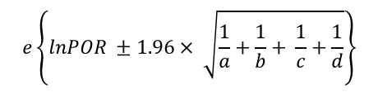
Data Analysis
Prevalence odds ratio (POR) – 95% CI
0.630 (0.554 – 0.715)
$$e\left\{lnPOR ±1.96× \sqrt{\frac{1}{a}+\frac{1}{b}+ \frac{1}{c}+\frac{1}{d}}\right\}$$
e $\left\{\ln\left(0.630\right)±1.96× \sqrt{\frac{1}{592}+\frac{1}{1589}+ \frac{1}{838}+\frac{1}{1415}}\right\}$
e {-0.591, -0.336}
or
(0.554, 0.715)
Notes:
This formula for calculating this confidence interval is also in your textbook. It looks similar to the calculation for the prevalence ratio, except that the part of the formula under the square root sign differs. Again, in these slides we replace “log” with “ln” and “exp” with “e”, to make the formula provided in your textbook more ‘explicit’ (i.e., conveyed most accurately). Again, here, we invite you to do the math for this calculation on your own, so you can practice it. Crunching these numbers, we find this confidence interval ranges from 0.554 to 0.715.

Slide 33
Choosing PR vs. POR
Prevalence ratio (PR) is preferred
POR typically overestimates RR, PR
PR will always underestimate an RR
At low prevalence (<5%) PR=POR=RR
Notes:
So, which measure do we choose – the prevalence ratio (PR) or the prevalence odds ratio (POR)? We know both are actually “wrong,” in this case, but which measure conveys the “least” wrong? Here, and in all cases for cross-sectional studies, it is the prevalence ratio (PR). It is this measure that we most prefer. Remember from Module 3 that the odds ratio overestimates the risk ratio (RR). The same is true for the prevalence ratio (PR). The prevalence odds ratio (POR) will typically overestimate the prevalence ratio (PR), also. In our example from the Framingham Heart Study, the prevalence odds ratio was further away from 1, which suggests a stronger protective effect for smoking.
As some of your additional reading for this week notes (e.g., Thompson et al, 1998), the prevalence ratio (PR) is a consistent, conservative, and easily interpretable estimate of the risk ratio (RR) (e.g., incidence rate ratio, or IRR) that would be calculated from the source cohort from which a cross-sectional study would be drawn. In other words, using a prevalence ratio (PR) we can never overstate cross-sectional study findings about the relationship between the exposure and outcome. Finally, it can be helpful to know that if the prevalence of the outcome is especially low (less than 5%), then all three types of measures should be almost equivalent (i.e., PR=POR=RR). Low prevalence outcomes are not well-suited for cross-sectional studies, however, as we said at the start. Stick with the prevalence ratio (PR), if you can.

Slide 34
Choosing PR vs. POR
When is the PR most appropriate?
for studies of acute diseases
when we are interested in disease burden
When is the POR most appropriate?
for studies of chronic diseases
for studies of long-lasting risk factors
when we are interested in disease etiology
Notes:
The suggestions on the previous slide are specific to mathematical properties of these measures. In other readings this week (e.g., Tamhane et al., Pearce et al.), alternative suggestions are made, given the type of exposure or outcome being studied, as well as the primary focus of the research question. As prevalence is an easier number to interpret and understand, the prevalence ratio (PR) can be helpful when implications of the study focus on quantifying the burden of disease the population experiences and providing reasons (e.g., possible risk factors) for the same. The odds ratio is so commonly used in epidemiology for etiologic studies of disease that it can simply be easiest to employ at times, too, in order to conduct studies and convey results, especially to a scientific audience. All readings this week emphasize the importance of using a proper measure of association (PR or POR) to satisfy the research question of interest. Focus, here.

Slide 35
Part D: Sources of Bias
Revisiting selection bias and information bias
Notes:
In Part B of this audiovisual presentation, we said there would be more information to come regarding selection bias and information bias that can sometimes occur in the context of cross-sectional studies. Now, we revisit biases and the systematic errors that generated them.

Slide 36
Selection Bias
Incidence-Prevalence Bias
Duration Ratio Bias (Survival Bias)
Prevalence Complement Ratio Bias
Notes:
Recall that selection bias occurs during the sampling phase of the study. As applied to cross-sectional studies, selection bias is often referred to as incidence-prevalence bias. This, in turn, is comprised of two specific types of bias: duration ratio bias (or survival bias) and prevalence complement ratio bias. The latter, as your textbook describes, are most easily understood upon mathematical derivation.

Slide 37
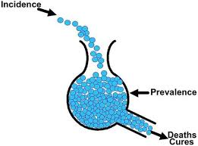
Incidence-Prevalence Bias
Prevalence = Incidence x Duration
Duration
Prevalence
Incidence
Prevalence
Notes:
From Epidemiology 1, you all should be familiar with the equation prevalence = incidence times duration. Prevalence is depicted as the steady state in the middle of the beaker, the mouth of which is open to new or incident cases and the bottom of which is open to deaths or survival. One can envision the implications, as if the duration of the disease went up (i.e., deaths and cures at the bottom went down), the prevalence would increase. Likewise, if the incident cases went up (i.e., new cases at the top went up) the prevalence would increase. Most prevalence estimates employ a point prevalence technique/method, taking a snapshot of the beaker at one particular point in time.

Slide 38
Incidence-Prevalence Bias
prev
= q x dur
(1 - prev)
prev
= q x dur x (1 – prev)
prev
= q x dur
~
Prevalence = Incidence x Duration
Notes:
The simple formula shown at the top of the previous slide and the bottom of this slide is actually derived from a more complicated one. In this derivation, we denote prevalence with prev, incidence with q, and duration with dur. The formula at the top of the slide represents the prevalence odds (instead of prevalence alone). This, technically speaking, is what is directly related to incidence (q) times duration (dur). If we solve for prevalence alone (prev), we see its complement (1-prev) moves to the right side of the equation. If prevalence is small, then its complement is roughly equivalent to 0 – therefore, prevalence (prev) is roughly equivalent to incidence times duration. We arrive where we started. But, as we will see in a moment, we will know this place better for it, especially as it relates to understanding these sources of bias.
Though our focus here is on describing these sources of error (i.e., bias) further, let us consider for a moment a solution to them. If the goal of an epidemiologic investigation is to examine disease etiology (i.e., test initial hypotheses regarding the determinants of disease), then the best approach is to enroll only incident cases in the investigation. That is, in this slide, the blue balls that drop in from the top, just as they land; not the blue balls that are buried way underneath or on their way out of the beaker on the backside. The solution is simple, but effective. The same approach (i.e., enrolling incident cases) can be used in case-control studies to prevent incidence-prevalence bias, too.

Slide 39
Incidence-Prevalence Bias
prev
=
q
X
dur
X
(1 – prev)
q +
(1 – prev +)
prev +
dur +
=
X
X
prev –
q –
dur –
(1 – prev – )
dur +
(1 – prev +)
PR
=
RR
X
X
dur –
(1 – prev – )
Notes:
The primary equation we were working with on the prior slide is shown at the top of this slide, here. Prevalence (prev) equals incidence (q) times duration (dur) times the complement of prevalence (1-prev). This equation predicts or models a prevalence estimate for the entire sample (or population), here. The equation below it compares the prevalence of the outcome in the exposed (prev+) to the prevalence of the outcome in the unexposed (prev-). This, to prepare us for the final equation, which demonstrates we are deriving prevalence ratios (PR) as a surrogate for (RR) risk ratios, which can be negatively impacted by duration ratio bias and prevalence complement ratio bias. This set of equations also underscores two important elements of a disease or outcome that are responsible for the difference between incidence and (point) prevalence: its duration and the magnitude of its (point) prevalence. If either differ between comparison groups (i.e., exposed v non-exposed), then bias will be problematic. The direction of the impact of these different sources of bias will differ, accordingly. The PR can be used to estimate the RR in a cross-sectional study, when there is little difference in the duration of disease and the prevalence of the disease both in the exposed and unexposed groups. You can see this here by focusing on the last two components of the final equation.

Slide 40
Incidence-Prevalence Bias
Duration Ratio Bias (Survival Bias)
Duration ratio bias > 1
Thus, overestimate risk
Duration ratio bias < 1
Thus, underestimate risk
dur +
dur –
Notes:
However, if the duration of disease and/or the prevalence are different between exposed subjects and unexposed subjects, we will have a hard time accurately estimating the RR from PR. The ratio of the duration of disease in the exposed and unexposed can be different. That, of course, results in duration bias. The impact of this bias on estimates of risk (e.g., RR, PR) can vary, depending on whether the duration of the disease after onset is longer or shorter in the exposed group compared to the unexposed group. Your textbook provides examples of each. Risk is overestimated when the duration of the disease in the exposed group is greater than that in the unexposed group. Men have a longer average survival time after a myocardial infarction than do women, for example. If men are considered an ‘exposure’, the duration ratio would be greater than 1. Thus, the prevalence ratio expressing the relationship of sex to myocardial infarction will be an overestimate. The second example your textbook provides is specific to cigarette smoking and emphysema. Smoking substantially decreases survival for those with emphysema. The duration of the disease in these patients, therefore, gets smaller. If smoking was considered as the exposure, then the duration ratio bias would be less than 1. Thus, the prevalence ratio for smoking on emphysema will be an underestimate, instead.
Let’s If prevalent cases of hypertension are enrolled into the study,
go back to our example from the Framingham Heart Study, which demonstrated a negative association between smoking and hypertension. The cases of disease that researchers identified were prevalent hypertensive cases at baseline. That is, researchers did not know the duration or time interval between the onset of hypertension and the day when cases were identified and enrolled into study. Having hypertension may cause a person to stop smoking or not stop smoking. That is, the disease, in this case, could cause the exposure.

Slide 41
Incidence-Prevalence Bias
Prevalence Complement Ratio Bias
Underestimates risk
Higher prevalence, PR
Overestimates risk
Lower prevalence, PR
(1 – prev +)
(1 – prev – )
Notes:
As we noted before, the prevalence ratio tends to underestimate the strength of the association between the exposure and the outcome, compared to a risk ratio (e.g., in cohort studies). It is for this reason that the prevalence ratio is the preferred measure of association in cross-sectional studies, where possible, as it is a conservative estimate of risk. The magnitude of this bias (i.e., underestimation) depends on both the prevalence and the prevalence ratio. The bias will be greatest when both the prevalence ratio and the prevalence ‘rate’ in one of the groups (e.g., exposed) are high. Your textbook provides an example of prevalence complement ratio bias, as it talks about TB tests. A few decades ago, it was shown that prevalence ratios linking a positive PPD (i.e., TB) test with clinical tuberculosis underestimated risk. It was later noted that this underestimation was likely exacerbated by the relatively high prevalence of clinical tuberculosis, given this source of bias. Generally speaking, higher prevalence and prevalence ratio will underestimate risk, while lower prevalence and prevalence ratio will overestimate risk. Prevalence here is specific to the outcome or disease. Risk is specific to the relationship between exposure and disease.

Slide 42
Information Bias
Temporal Bias
Effect leads to cause?
Cause leads to effect?
Notes:
The last source of bias we want to consider in cross-sectional studies is a straightforward one: temporal bias. Your textbook considers this as an example of information bias. Temporal bias occurs when the inference about the proper temporal sequence of cause and effect is wrong. That is, when we assume a cause created the effect when, in fact, the effect created the cause. The term reverse-causality is often used in connection with temporal bias. Temporal bias is always a threat to the validity of cross-sectional studies. Its impact is not felt on a estimate of risk, like that shown in the previous slides. Rather, its impact is on causal inference itself, of which temporality is a key factor.
Let’s go back to our example from the Framingham Heart Study and the fact that we calculated an inverse association between smoking and hypertension. Note that the hypothesis they were (initially) testing is whether smoking ‘causes’ hypertension. But it is also possible that having hypertension could cause a person to stop smoking or not stop smoking, given physician intervention at the time (or after a) diagnosis. That is, the disease, in this case, can cause the exposure. This is problematic in a cross-sectional study, as temporal differences between the exposure and the disease are difficult to entangle. Sometimes, this can be done with a simple adjustment to the measure. In contemporary research on smoking, participants are often asked, “in the past 30 days, how often have you smoked a cigarette?” This is a common measure used on cross-sectional surveillance study instruments. It anchors in an exposure in a past time for the present analysis.

Slide 43
MODULE 7: Cross-sectional studies, 1
In this Module, we learned about cross-sectional studies, the first Module in a series of Modules specific to different study designs in epidemiology
Notes:
That does it for this audiovisual presentation for Module 7! Don’t forget to watch the video from Dr. Caetano on sampling. The link for this video is on the Instruction Sheet for this Module. See you on the Discussion Board!

